Slide 1
Data Preprocessing
Unsupervised Clustering
Clusters Validation
Data Interpretation
R package 1
R package 2
R package 5
(All variables)
Check missingness
Data standardization
Clean data
(zBMI_24m)
NbClust voting for K
Elbow method
Silhouette Analysis
PCA Visualization
Multiple K Comparison
Index Heatmap
(zBMI_24m)
Internal validation
R package 3
(zBMI_24m)
Euclidean metric
Manhattan metric
R package 4
(zBMI_24m)
K-Means clustering
PAM clustering
Hierarchical clustering
Notes:
Pipeline Flow Brief Outline with R Packages

Slide 2
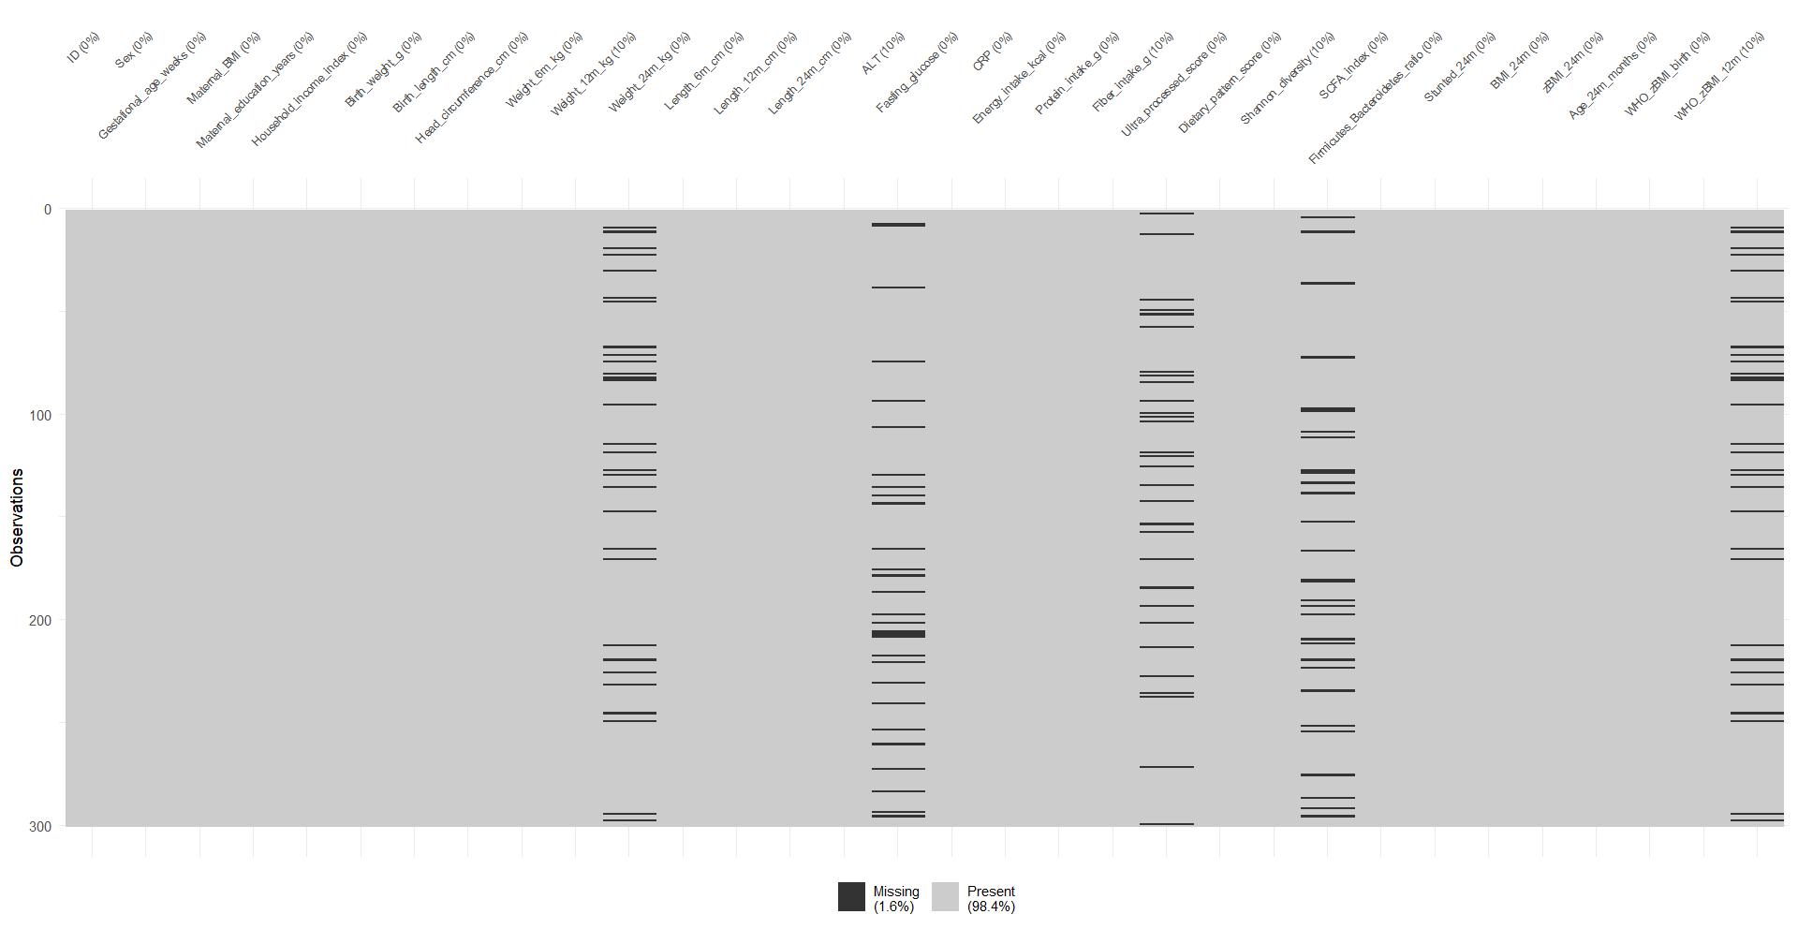
Notes:
Graph 1. Visual inspection of missing data
R package Line 38 (modified to fit in the frame)

Slide 3
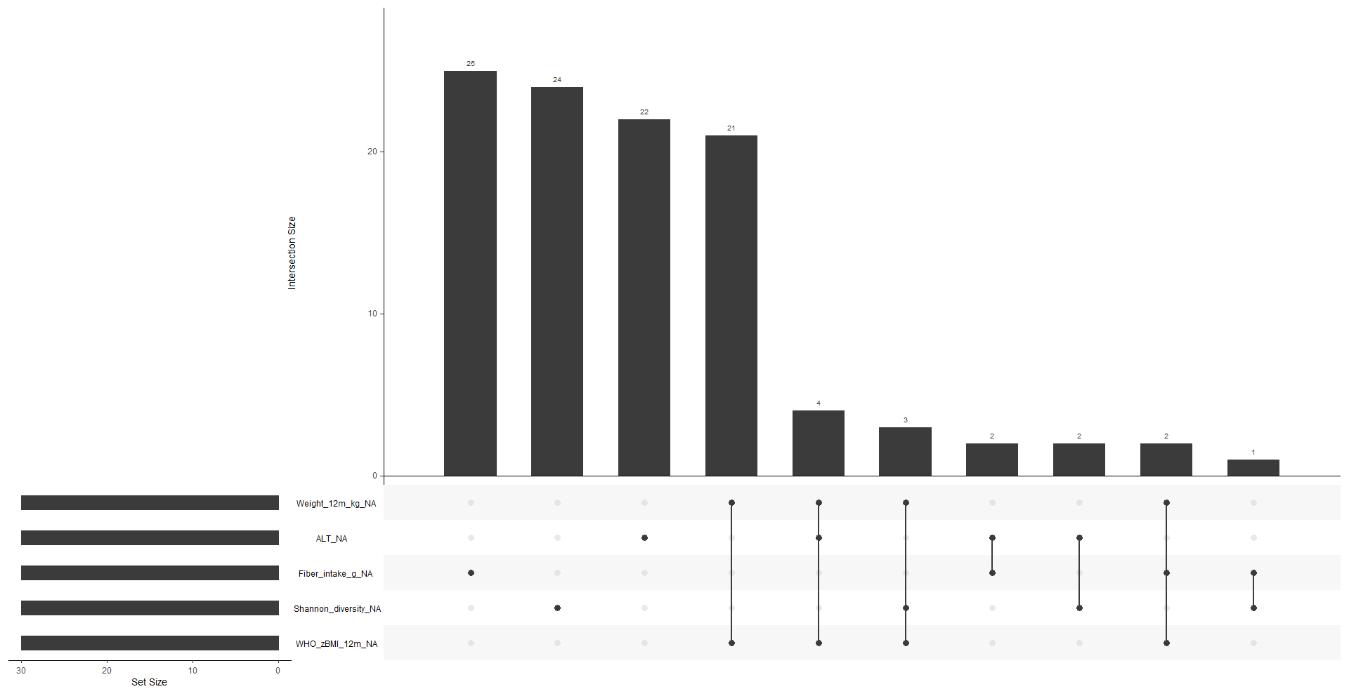
Notes:
Graph 2. Missingness combinations
R package Line 41

Slide 4
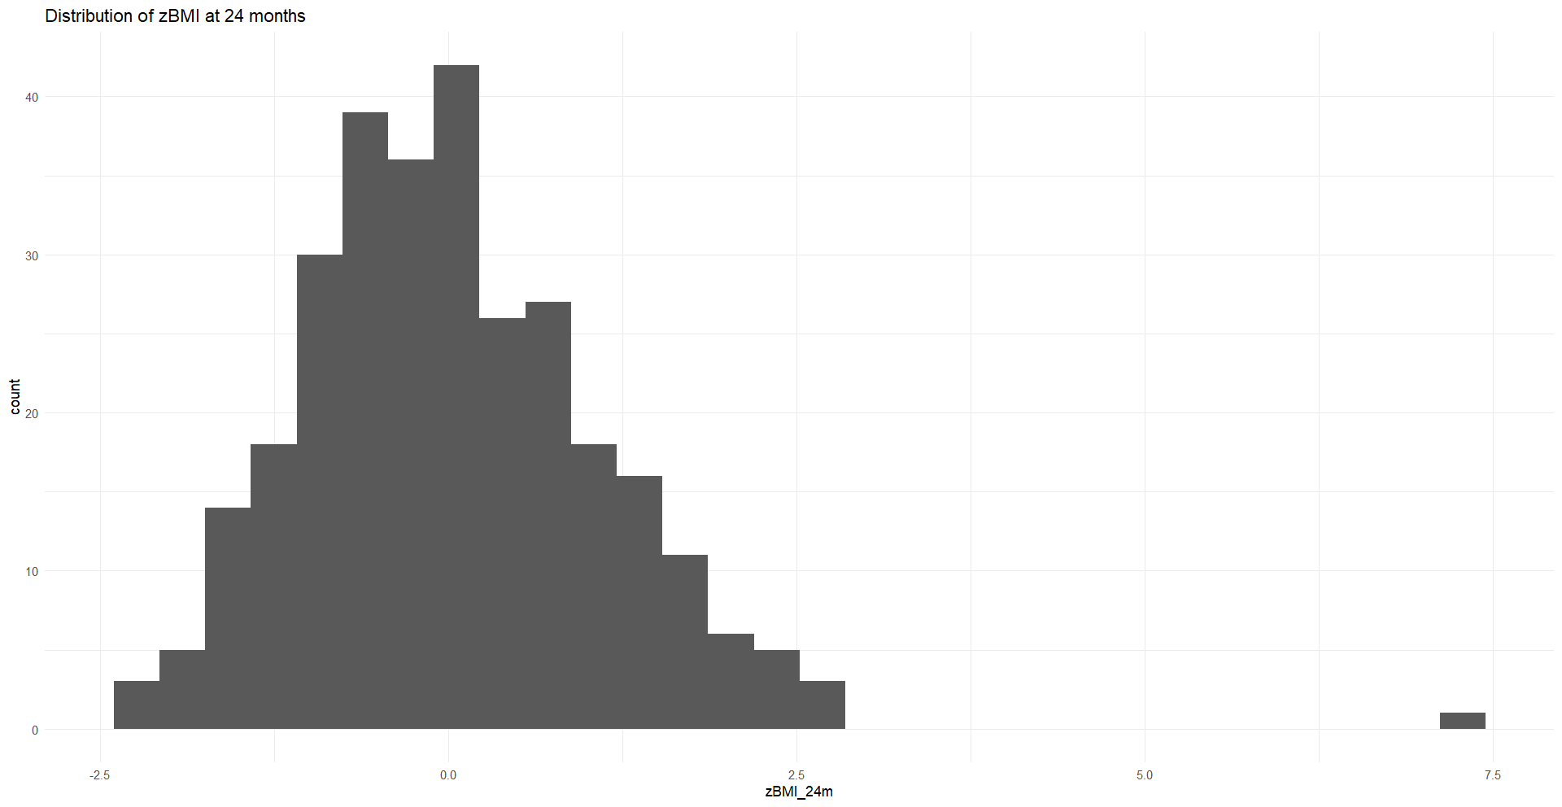
Notes:
Graph 3. Distribution of zBMI at 24 months
R package Line 55

Slide 5
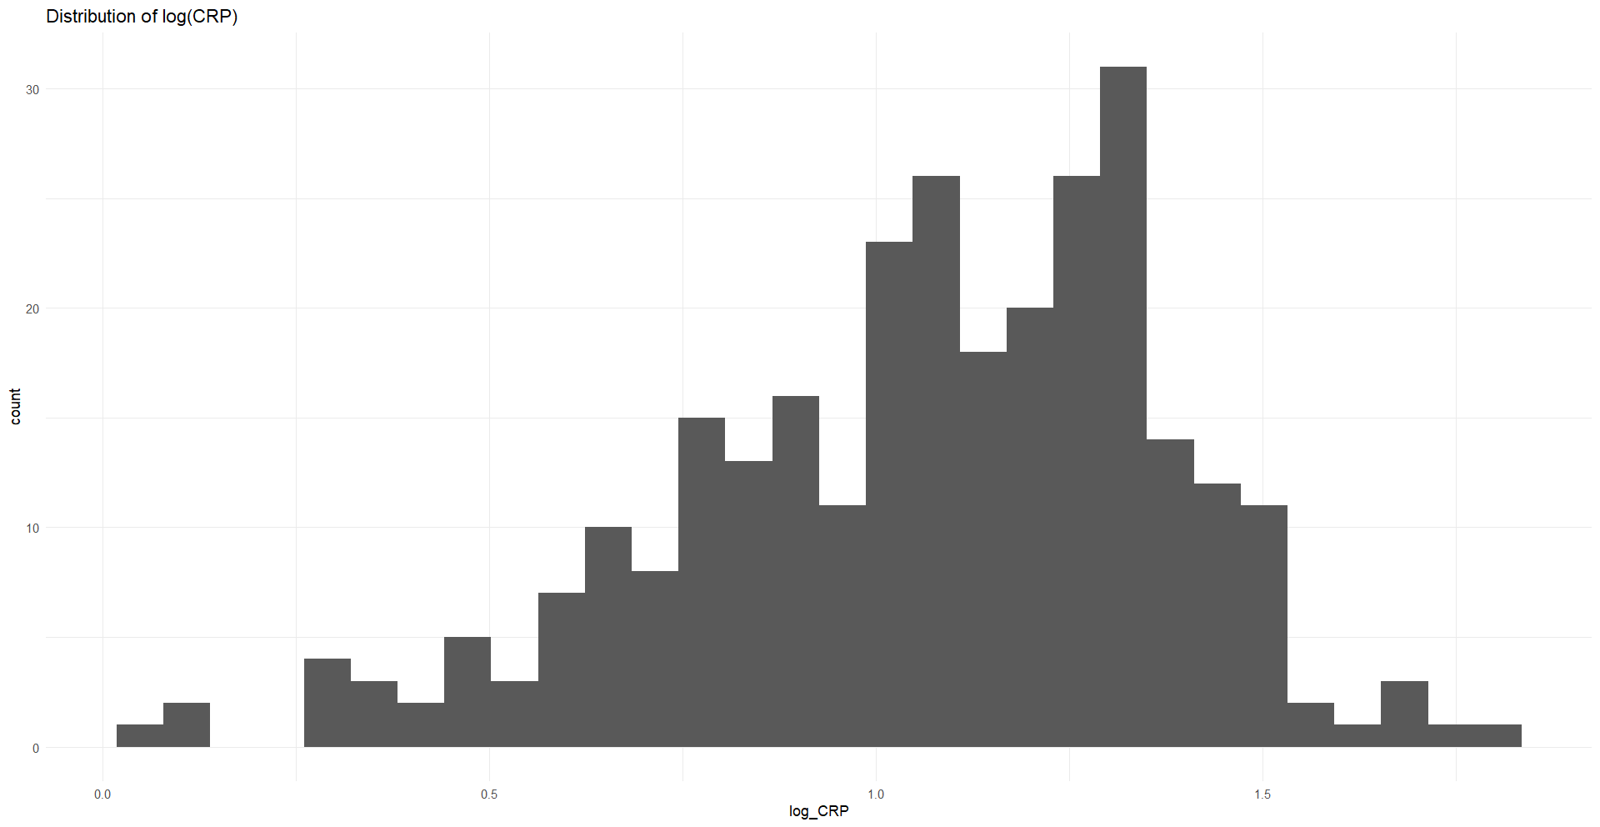
Notes:
Graph 4. Distribution of CRP log transformed
R package Line 65 (modified to handle 11 negative values; changed to N/A if negative)

Slide 6
Preprocessing Section: Identifying and removing implausible values
Implausible age values
Implausible age values: 4
ID: 83, 144, 179, 192
WHO-style plausibility cut-offs for zBMI
Implausible zBMI values: 1
ID: 294
Extreme CRP values (possible acute infection)
Implausible CRP values: 0
Original sample size = 300
After cleaning = 295
Notes:
R package Lines 91 to 132 (modified to visualize the data and keep the codes consistent for cleaning)

Slide 7
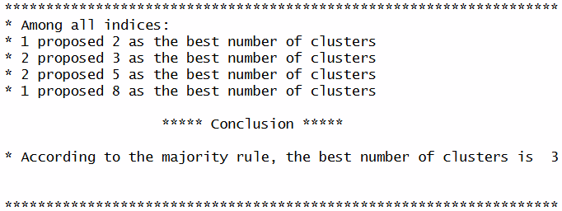
Assessing Clustering Tendency: NBClust Analysis
Notes:
R package Line 183
Optimal K = 3

Slide 8
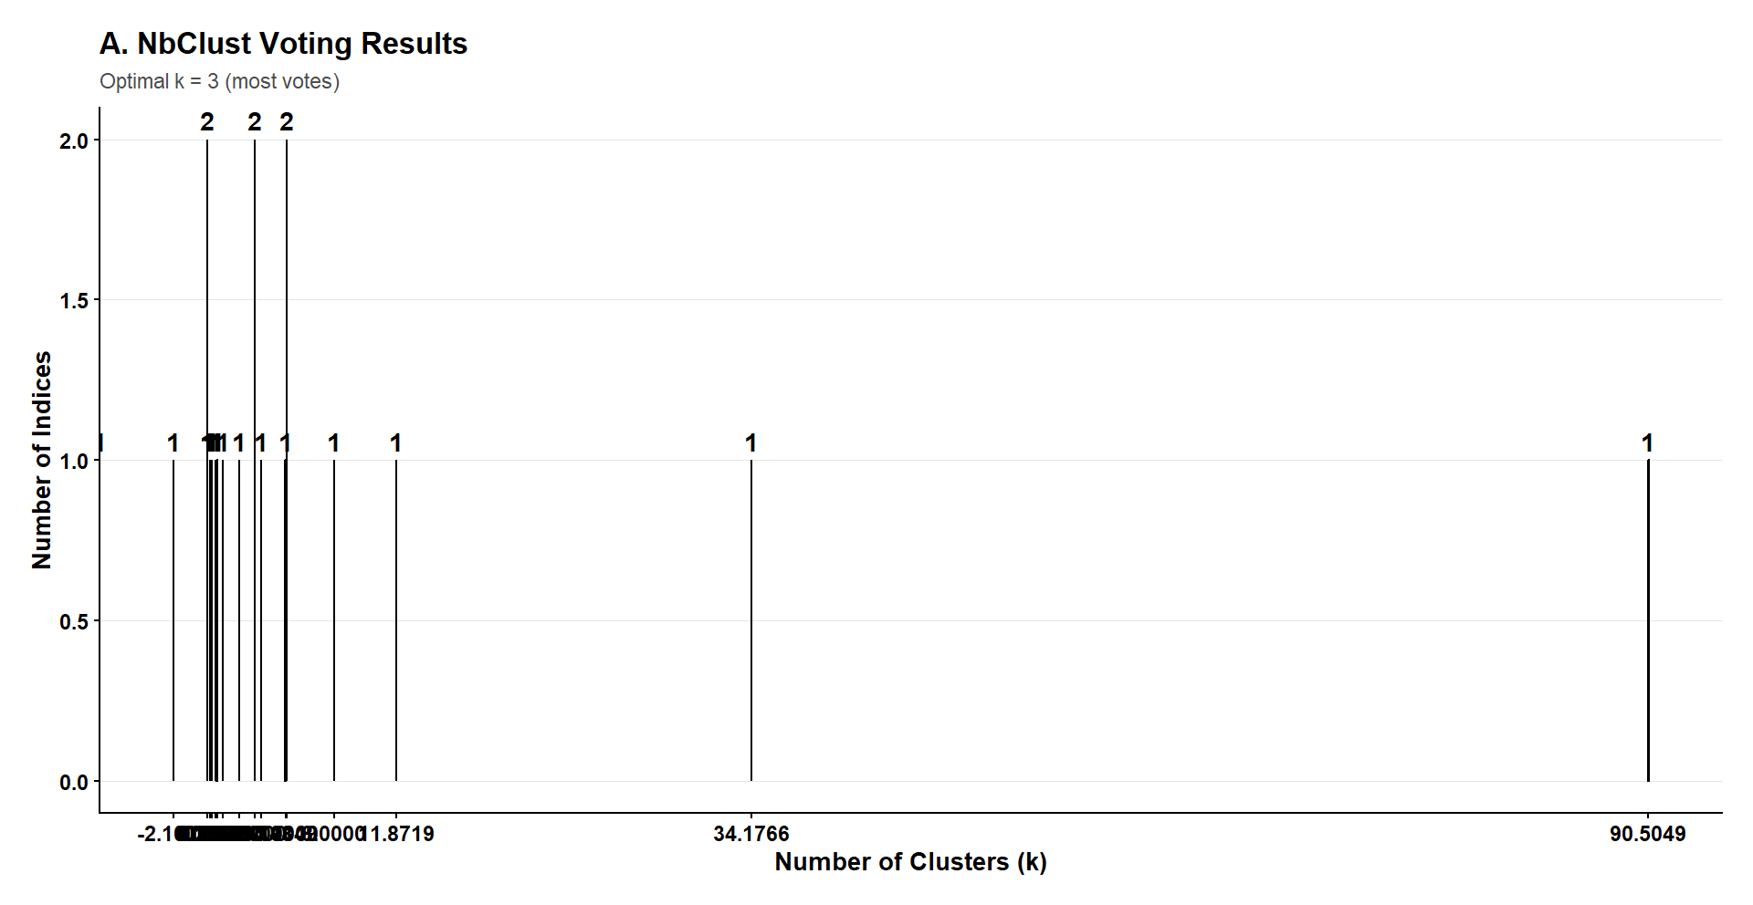
Notes:
Graph 5. NBClust voting results
R package Line 211

Slide 9
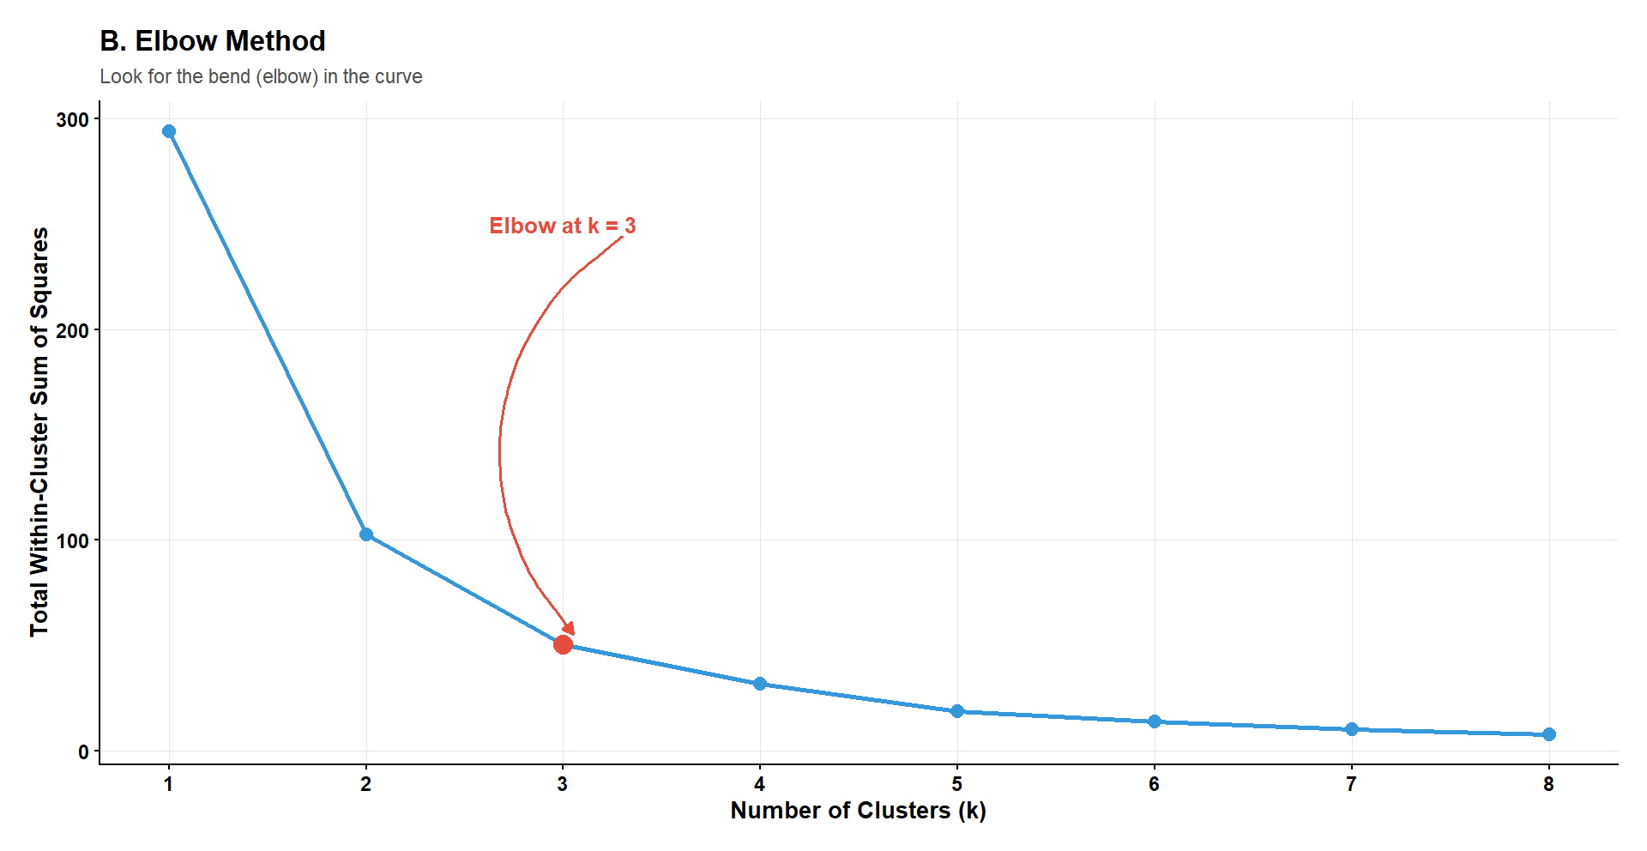
Notes:
Graph 6. Elbow method for number of clusters results
R package Line 247

Slide 10
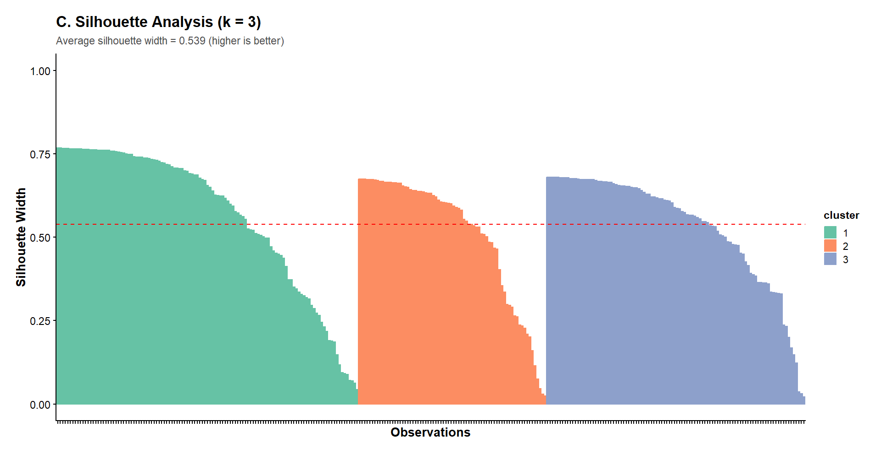
Notes:
Graph 7. Silhouette Analysis for number of clusters results
R package Line 284

Slide 11
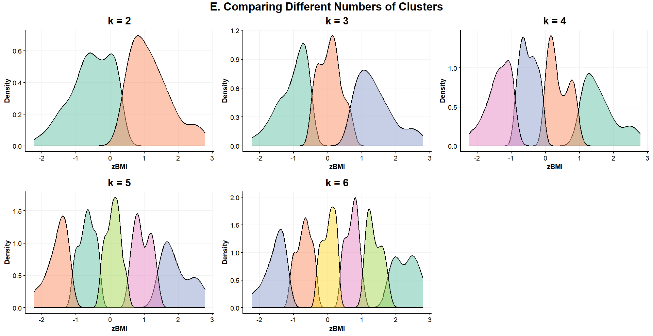
Notes:
Graph 8. Comparison of different numbers of clusters
R package Line 345

Slide 12
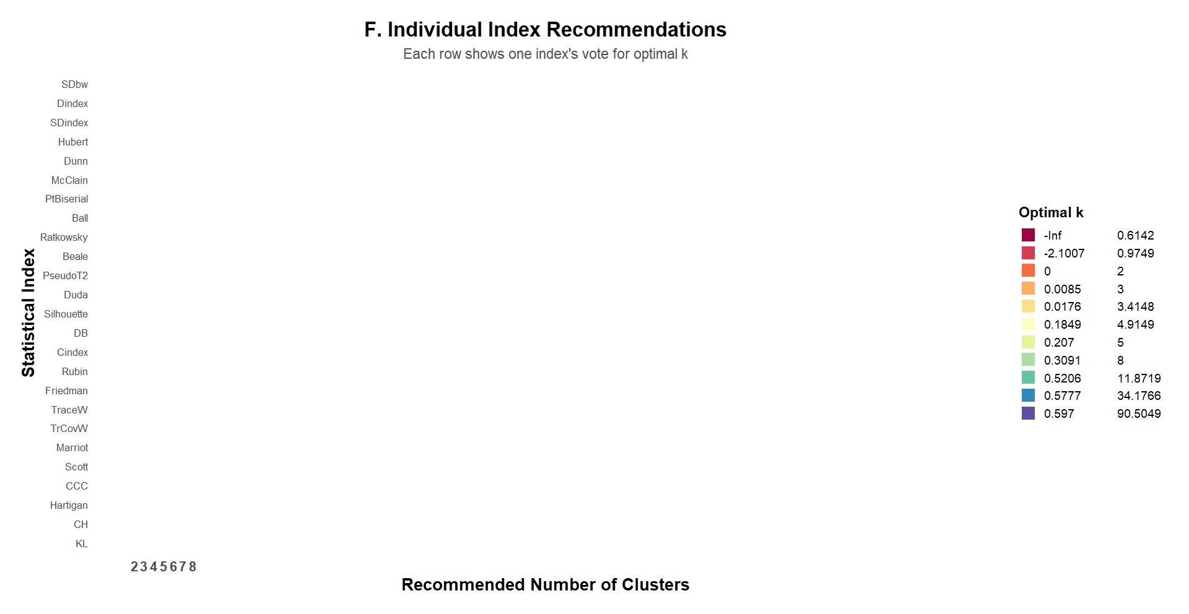
Notes:
Graph 9. Index heatmap
R package Line 367

Slide 13
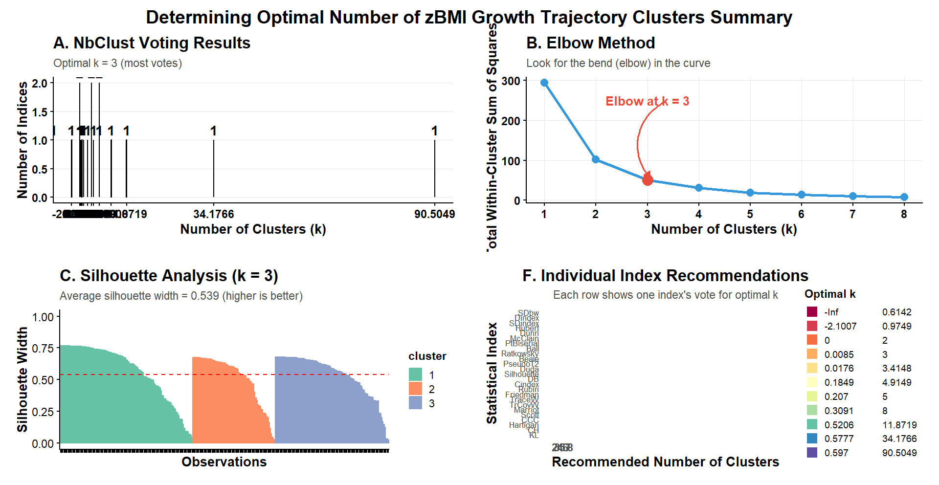
Notes:
Graph 10. Summary of optimal number of clusters
R package Line 396

Slide 14
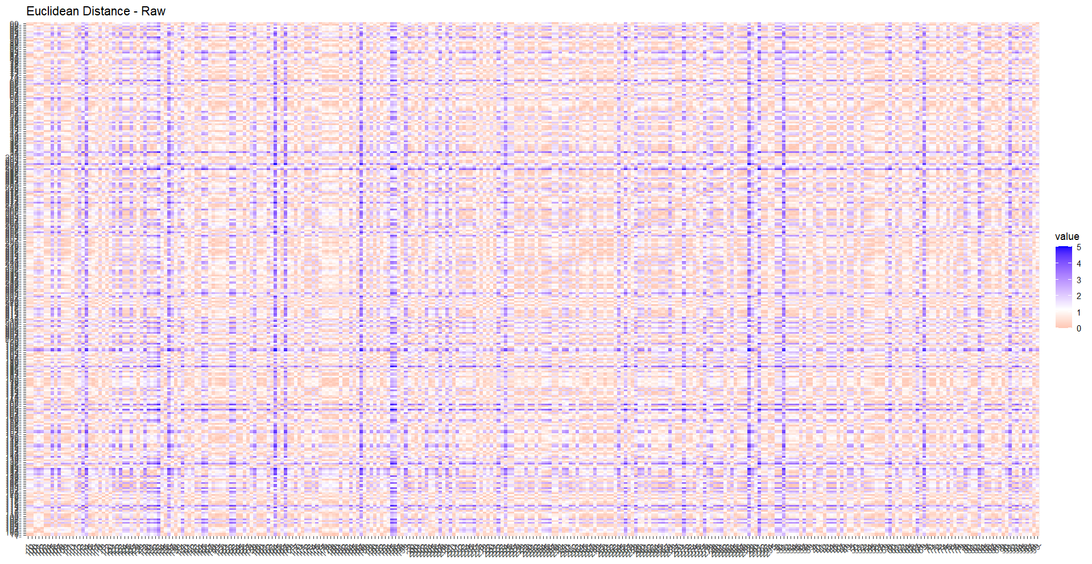
Notes:
Graph 11. Euclidean distance raw results
R package Line 446

Slide 15
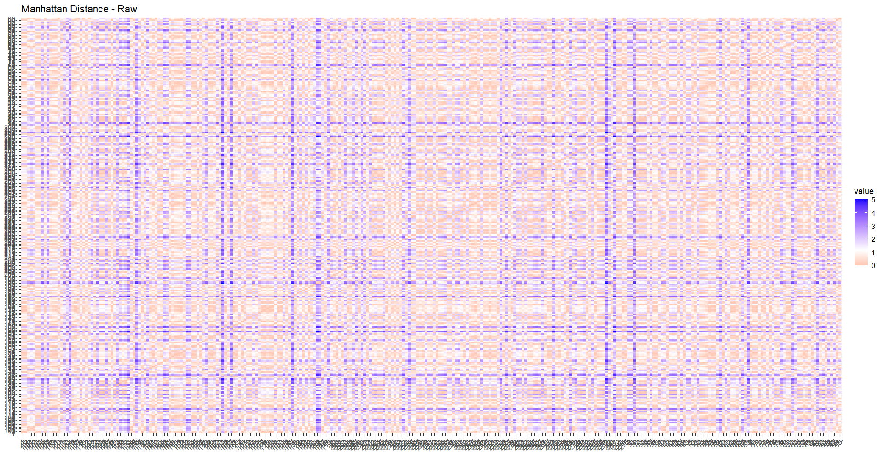
Notes:
Graph 12. Manhattan distance raw results
R package Line 447

Slide 16
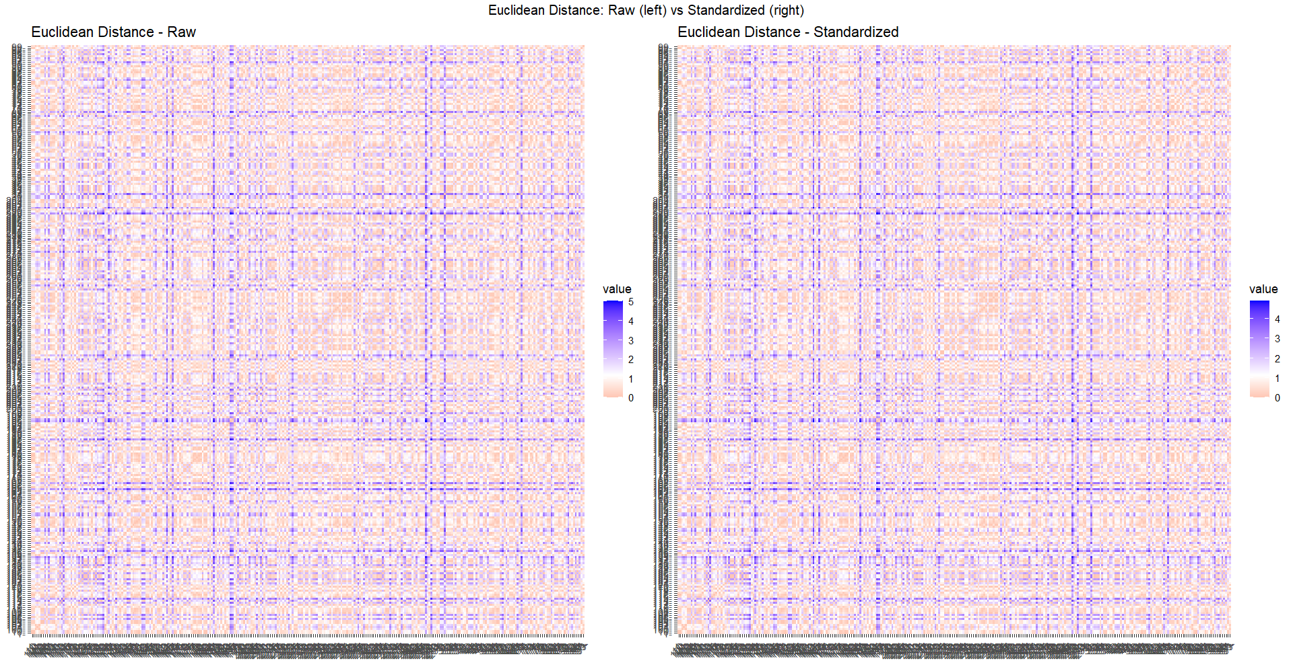
Notes:
Graph 13. Standardized data vs. raw data of Euclidean Distance
R package Line 461

Slide 17
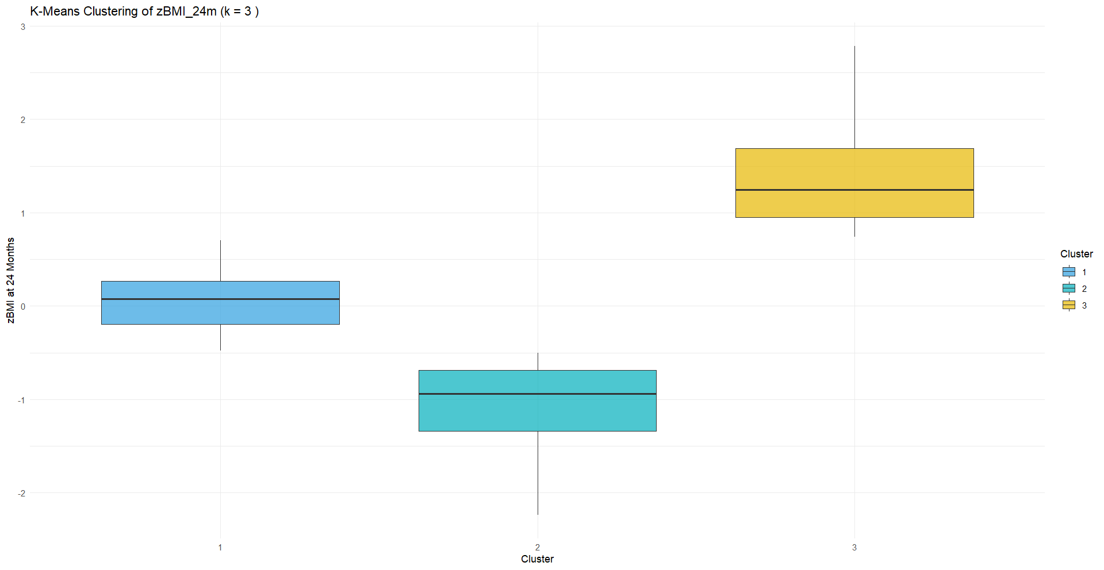
Notes:
Graph 14. K-means clustering of zBMI_24m (Boxplot)
R package Line 536

Slide 18
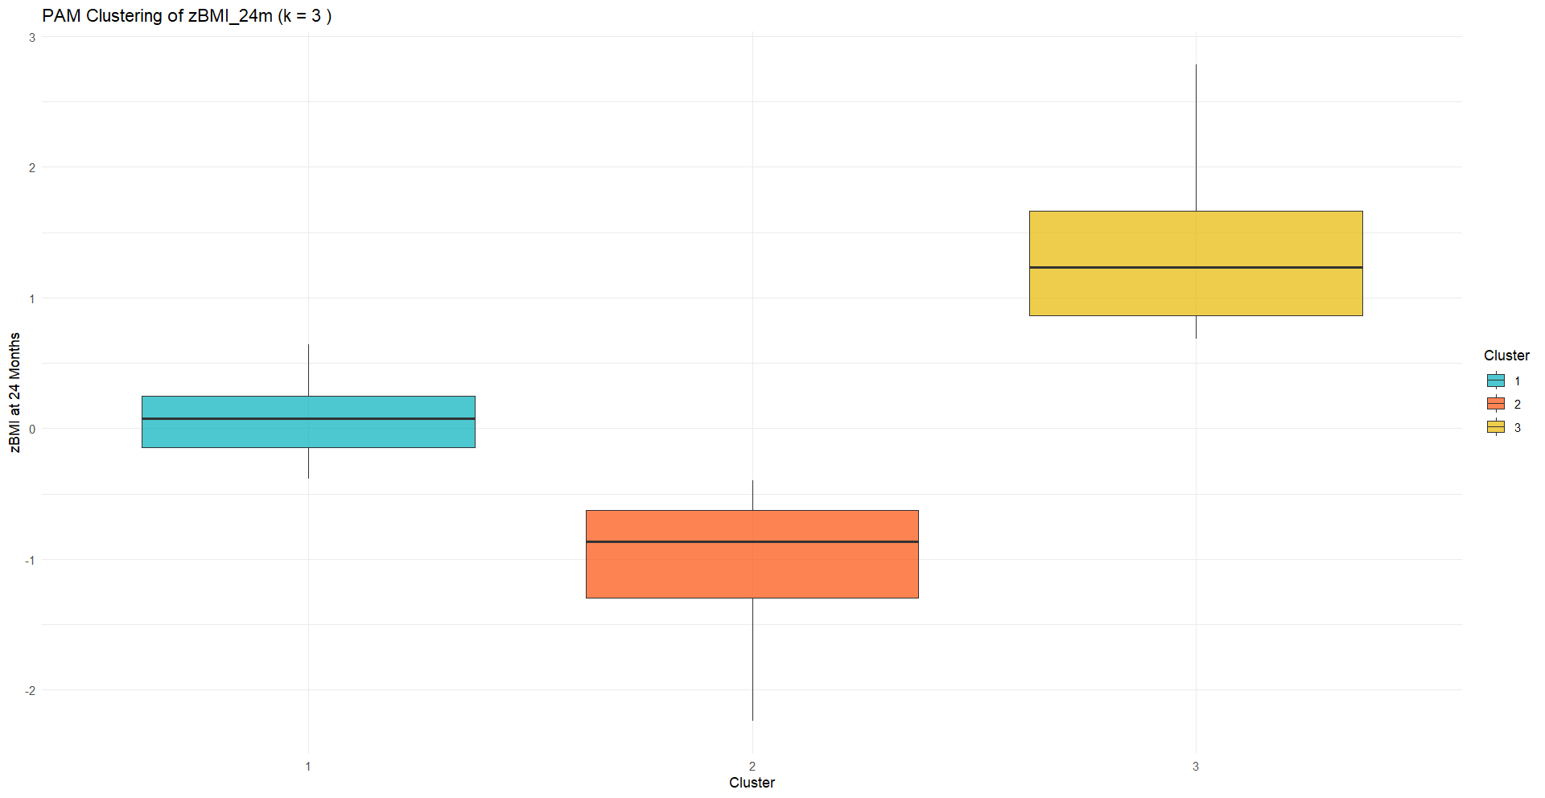
Notes:
Graph 15. PAM clustering of zBMI_24m (Boxplot)
R package Line 569
Line 581 is added “table(pam.res$clustering)” to visualize the results

Slide 19
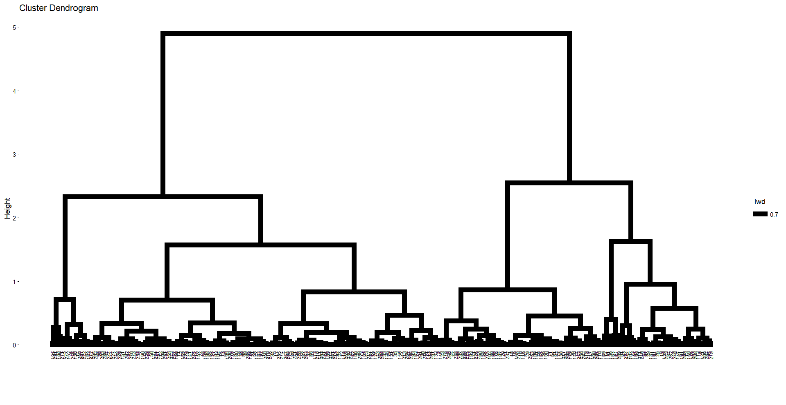
Notes:
Graph 16. Hierarchical cluster dendrogram of zBMI_24m
R package Line 594

Slide 20
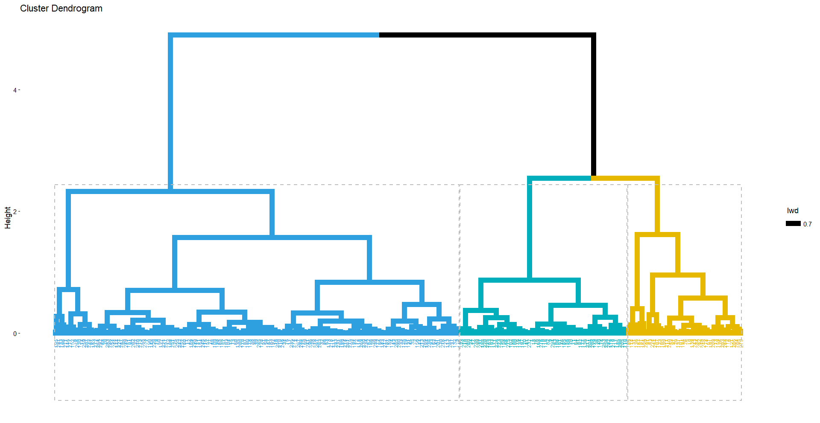
Notes:
Graph 17. Hierarchical cluster dendrogram of zBMI_24m (colored)
R package Line 606

Slide 21
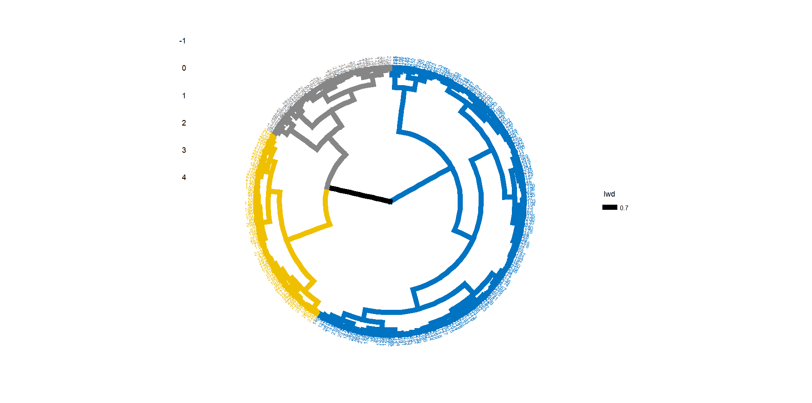
Notes:
Graph 18. Hierarchical cluster circular dendrogram of zBMI_24m
R package Line 618

Slide 22
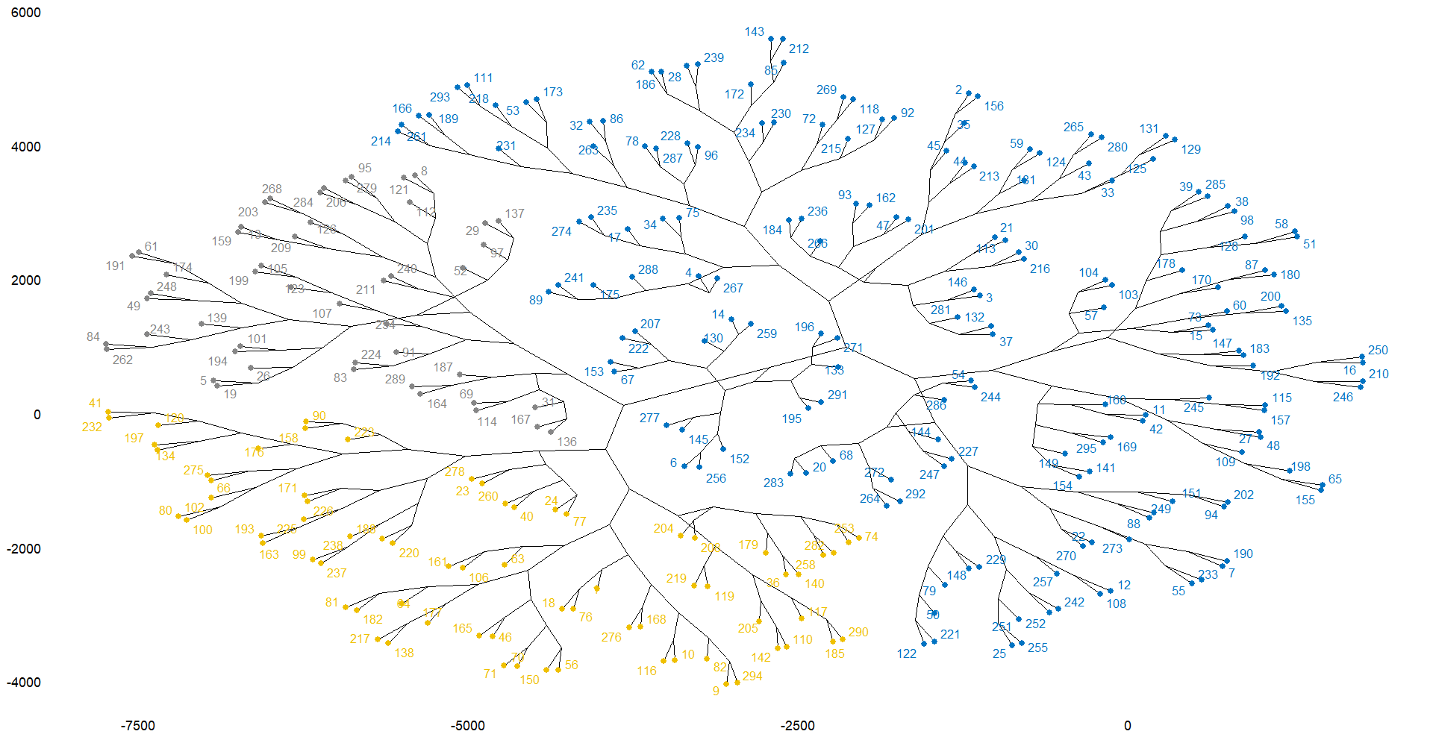
Notes:
Graph 19. Hierarchical cluster phylogenic tree of zBMI_24m
R package Line 629

Slide 23
Clustering: Growth Trajectory Clusters Summary
 | K-Means | Partitioning Around Medoids (PAM) | Hierarchical Clustering
 | Average zBMI of each group | Real children as cluster centers | A dendrogram showing how children are progressively grouped together
# of children | Cluster 1 = 119 Cluster 2 = 102 Cluster 3 = 74 | Cluster 1 = 104 Cluster 2 = 112 Cluster 3 = 79 | Cluster 1 = 72 Cluster 2 = 174 Cluster 3 = 49
Mean zBMI | Cluster 1 = 0.045 Cluster 2 = -1.032 Cluster 3 = 1.350 | Cluster 1 = 0.063 (ID 38) Cluster 2 = -0.852 (ID 175) Cluster 3 = 1.186 (ID 101)
Raw Interpretation | Cluster 1 = normal growth (~ 0 mean) Cluster 2 = lower growth (~ -1 mean) Cluster 3 = higher growth (~ +1.4 mean)
K-Means and PAM demonstrate that k=3
is a robust and valid solution for zBMI_24m
Notes:
Summary of clusters

Slide 24
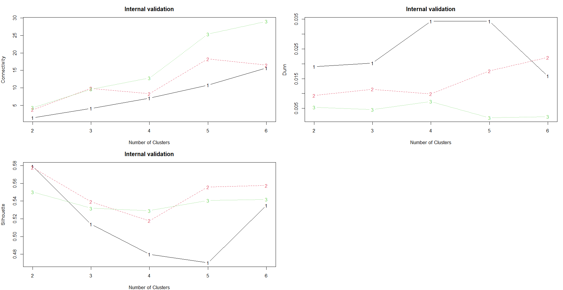
Higher the better
Lower the better
Higher the better
Connectivity = hierarchical wins; k = 2
Dunn = hierarchical wins; k = 4
Silhouette = hierarchical wins; k = 2
Notes:
Graph 20. Internal validation of zBMI_24m clusters (black = hierarchical, red = k-means, green = PAM)
R package Line 682

Slide 25
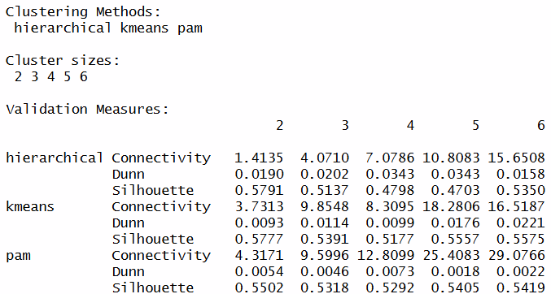
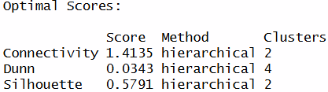
Internal Validation Summary
Internal validation shows that Hierarchical Method at 2 clusters (k = 2) produces the best results mathematically.
However, it’s biologically meaningful to have 3 clusters (k = 3), which captures the growth heterogeneity.
K-Means, therefore, is the right choice for our research question

Slide 26
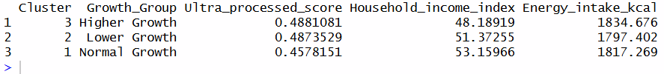
Clustering Profiling
Compare maternal predictor variables across clusters
(mean values of each predictor variable within each zBMI_24m cluster):
K-Mean Method | Ultra processed score mean value | Household income index mean value | Energy intake (kcal) mean value
Cluster 3 (Higher growth) 74 children | 0.488 | 48.19 | 1834.68
Cluster 2 (Lower growth) 102 children | 0.487 | 51.37 | 1797.4
Cluster 1 (Normal growth) 119 children | 0.458 | 53.16 | 1817.27
Notes:
R package Line 700 onwards

